Slide 1
8.3 The Linear Autoencoder and Principal Component Analysis

Slide 2
The most fundamental unsupervised learning method is known as Principal Component Analysis or PCA for short.
It follows directly from our discussion in the previous section regarding fixed spanning set representations with one crucial caveat.
instead of just learning the proper weights to best represent input data over a given fixed spanning set we learn a proper spanning set as well.

Slide 3
Learning proper spanning sets

Slide 4

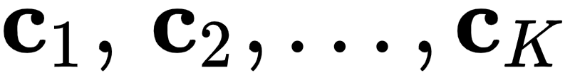
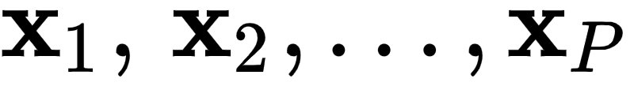
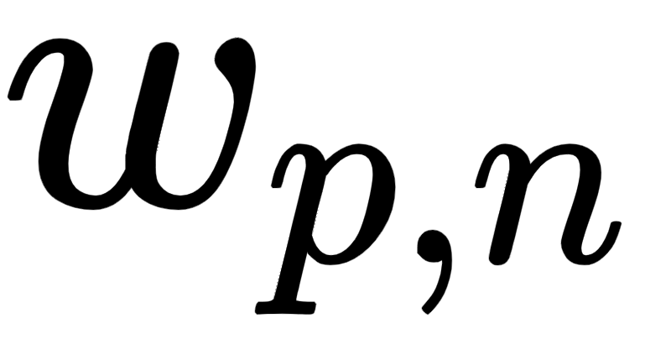
Given a fixed basis or spanning set of vectors - we can represent a set of P mean-centered points as
Here we tune the weights by minimizing a Least Squares cost function
In general when we used a full set of linearly independent K = N fixed basis vectors we can learn corresponding weights that drive this cost function to zero, and give us strict equality in the desired equation.

Slide 5

In the previous Section we supposed that our spanning set / basis was fixed.
However here we will learn a proper basis (along with the weights).
This slight thematic twist - where we learn the basis along with the proper weights - is called Principal Component Analysis.

Slide 6


How can we learn a proper basis for a given dataset?
With an ideal basis and properly tuned our weight vectors / encodings we could drive the value of the Least Squares error above even lower than we could with any fixed basis.
So to learn a quality basis we should be minimizing the cost function above over as well as the weight vectors / encodings

Slide 7
Adding to the list of optimization variables we need to minimize with respect to, this Least Squares cost function takes the similar form
Again - the only thing that has changed here is that now (since we aim to learn the basis as well, it has been added to the list of variables we wish to minimize the original Least Squares cost function with respect to.

Slide 8
This cost function can be properly minimized using any number of standard approaches like e.g., gradient descent or coordinate / block-coordinate descent.
Below we look at a few simple examples where we use gradient descent to minimize the cost, determining proper bases and weight vectors.

Slide 9
Example: Learning a complete basis via gradient descent

Slide 10
In this first example we will use gradient descent to determine a *complete* basis for the two dimensional data shown below.
We will also center the data below by subtracting off the mean of each input dimension.

Slide 11
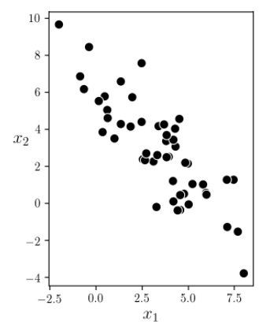

Slide 12

Now we can implement the least squares cost function.
To stay consistent with our style for implementing cost functions, we will input package the weights for and in a single input list `w` as `w = [C,W]`.
Once inside the cost function we can then simply strip off each matrix of weights and compute the cost function, as shown below in the implementation.

Slide 13
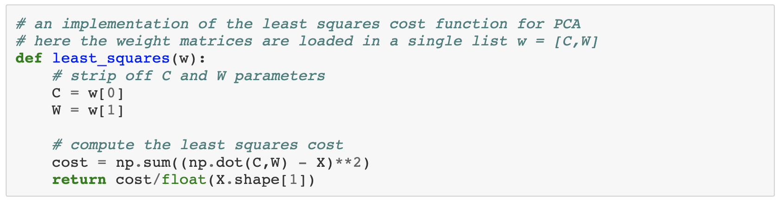

Slide 14
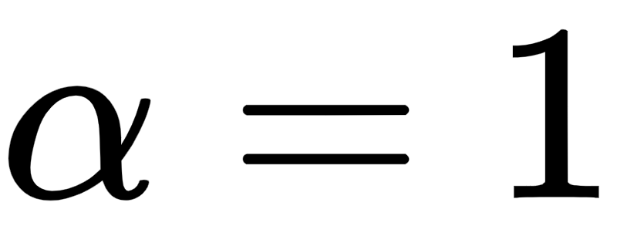
Now make a run of 100 gradient descent steps with a fixed steplength parameter for all steps in order to minimize the PCA Least Squares cost function implemented above.
Here we use the implementation of gradient descent given in [Section 3.6], which we employ via a backend file.
With our gradient descent run complete we can plot the associated cost function history to make sure the method has converged sufficiently for our settings. We do this below.

Slide 15
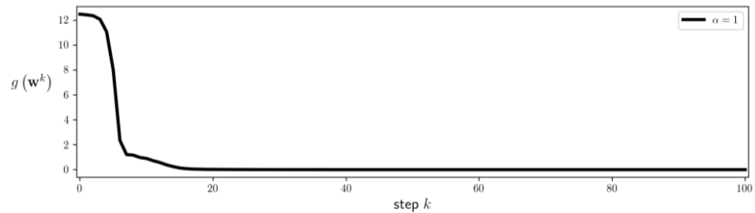

Slide 16
In the left panel below we plot our best recovered basis (from the final step of the run above) along with the original data.
Here the two basis vectors - shown as red arrows - are essentially two random vectors in the plane.
Essentially any two random vectors will do here since they will span the entire space of the data, giving a perfect representation.
In the right panel we plot the encoded version of the data - i.e., the associated learned weight vectors (see the previous Section if this nomenclature is unfamiliar).

Slide 17
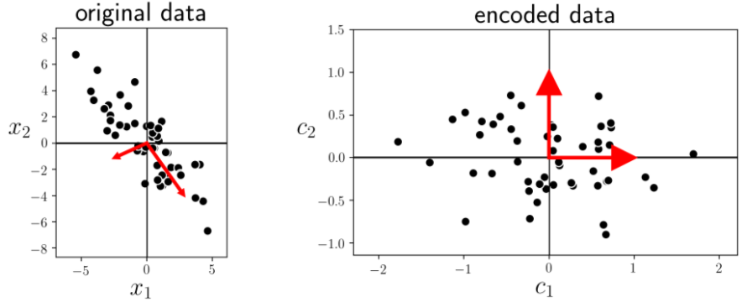

Slide 18
To empirically validate (at least to some degree) the notion that proper minimization will - in this instance - recover essentially any two random vectors, we show the results of three more runs of gradient descent using the same parameters as above but with a random initialization in each instance.
We plot the best recovered basis in each instance afterwards, and as we can see each instance differs considerably from the others (recovering two linearly independent vectors in each case).

Slide 19
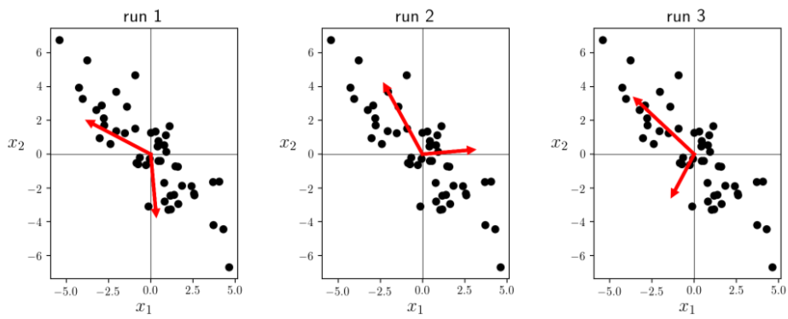

Slide 20
Example: Learning a proper subspace via gradient descent

Slide 21
In this example we use gradient descent to minimize the PCA Least Squares cost in order to learn the best two-dimensional subspace representation of an N=3 dimensional dataset consisting of 100 points.
We load in the dataset below and mean-center it.

Slide 22
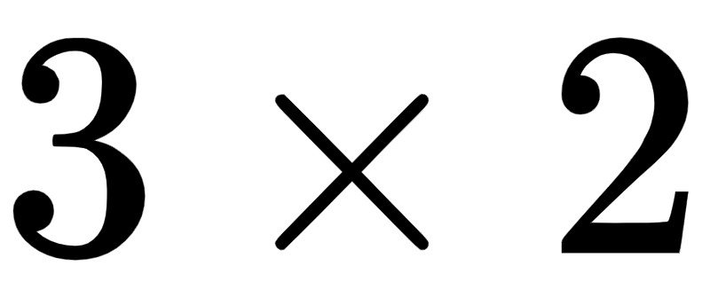
Now we make a run of 100 gradient descent steps with a fixed steplength value of for each step.
With these settings gradient descent converges very well. Notice: to learn 2 basis elements we initialize as a random matrix (i.e., it will have only two spanning vectors), and likewise initialize each weight vector to have only two entries.

Slide 23


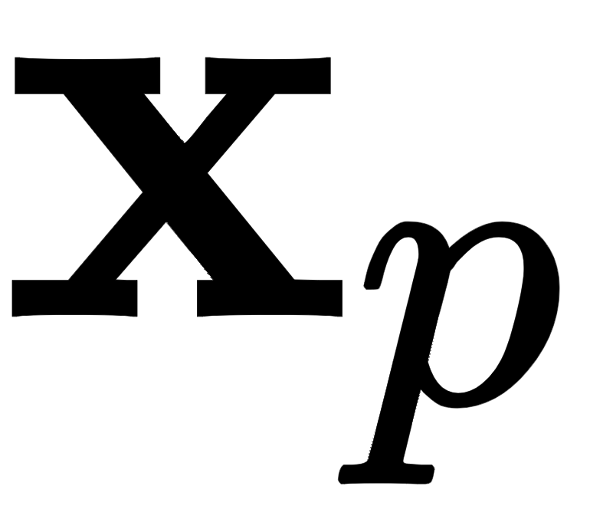
With this run complete we can plot our two learned spanning vectors and , the two-dimensional subspace it spans, etc., We do this below.
The left panel shows the original data (as gray dots), learned spanning vectors (shown as red arrows), and corresponding subspace colored in light red.
This is the very best two-dimensional subspace representation for the input data. In the middle panel we show the corresponding learned weight vectors / encodings of the original input in the space spanned by the recovered spanning vectors.

Slide 24
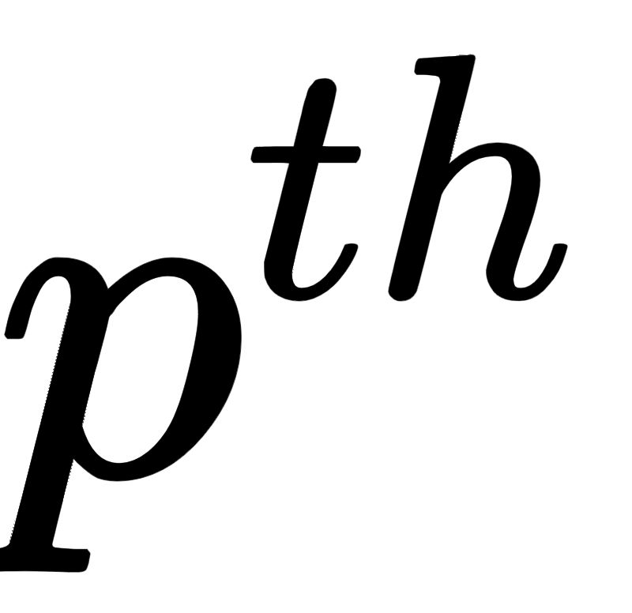
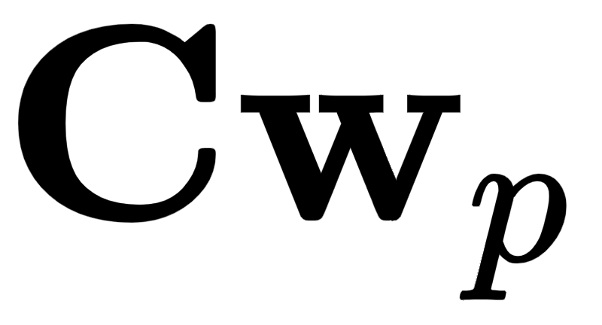
In the right panel we show the original data space again and the decoded data points (gray dots with red borders) - i.e., the projection of each datapoint onto the space spanned by our learned basis.
As detailed in the previous Section the decoded version of the point is computed as , where and are the fully learned basis and encoding for the point.

Slide 25
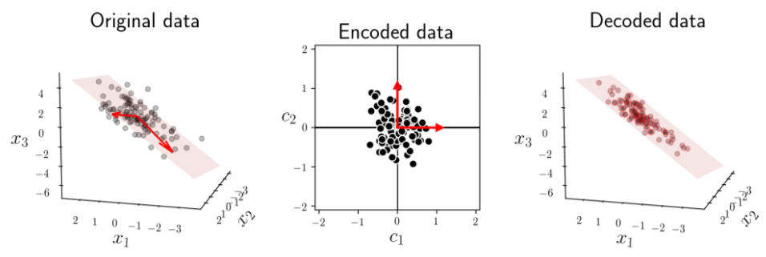

Slide 26
The linear Autoencoder

Slide 27
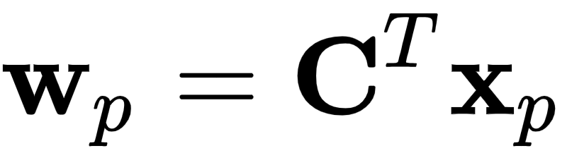

As detailed in the previous Section, if our K spanning vectors concatenated column-wise to form the spanning matrix are orthonormal, then the encoding of each may be written simply as
If we plug in this simple solution for into the pth summand of the Least Squares cost above, we get a cost that is a function of

Slide 28
We can think of this Least Squares as enforcing the Autoencoder formulae shown in the prior Section to hold when properly minimized, and thus it is often referred to as the linear Autoencoder.
Instead of being given an encoding/decoding scheme for each data point, by minimizing this cost function we learn one.
Even though we were led to the linear Autoencoder by assuming our spanning matrix is orthonormal, we need not enforce this condition because it can be shown that the minima of the linear Autoencoder are indeed always orthonormal.

Slide 29
Example: Learning a linear Autoencoder using gradient descent

Slide 30
In the left panel of Figure 8.5 we show a mean-centered two-dimensional dataset, along with a single spanning vector (i.e., K = 1) learned to the data by minimizing the linear Autoencoder cost function above using gradient descent.
The optimal vector is shown as a red arrow in the left panel, the corresponding encoded data is shown in the middle panel, and the decoded data in the right panel along with the optimal subspace for the data (a line) shown in red.

Slide 31
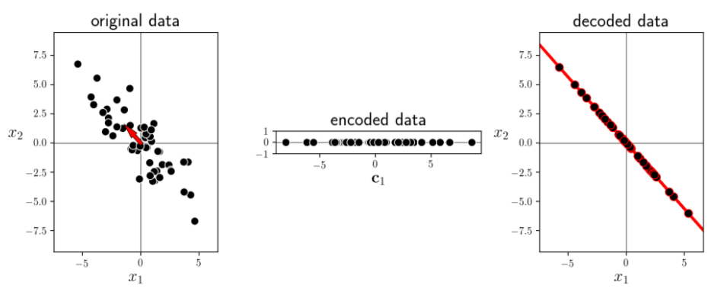

Slide 32
Principal Component Analysis

Slide 33
The linear Autoencoder cost may have many minimizers, of which the set of principal components is a particularly important one.
The spanning set of principal components always provide a consistent skeleton for a dataset, with its members pointing in the dataset’s largest directions of orthogonal variance.
Employing this particular solution to the linear Autoencoder is often referred to as Principal Component Analysis, or PCA for short, in practice.

Slide 34
This idea is illustrated for a prototypical N = 2 dimensional dataset in Figure 8.6, where the general elliptical distribution of the data is shown in light grey.
A scaled version of the first principal component of this dataset (shown as the longer red arrow) points in the direction in which the dataset is most spread out, also called its largest direction of variance.
A scaled version of the second principal component (shown as the shorter of the two red arrows) points in the next most important direction in which the dataset is spread out that is orthogonal to the first.

Slide 35
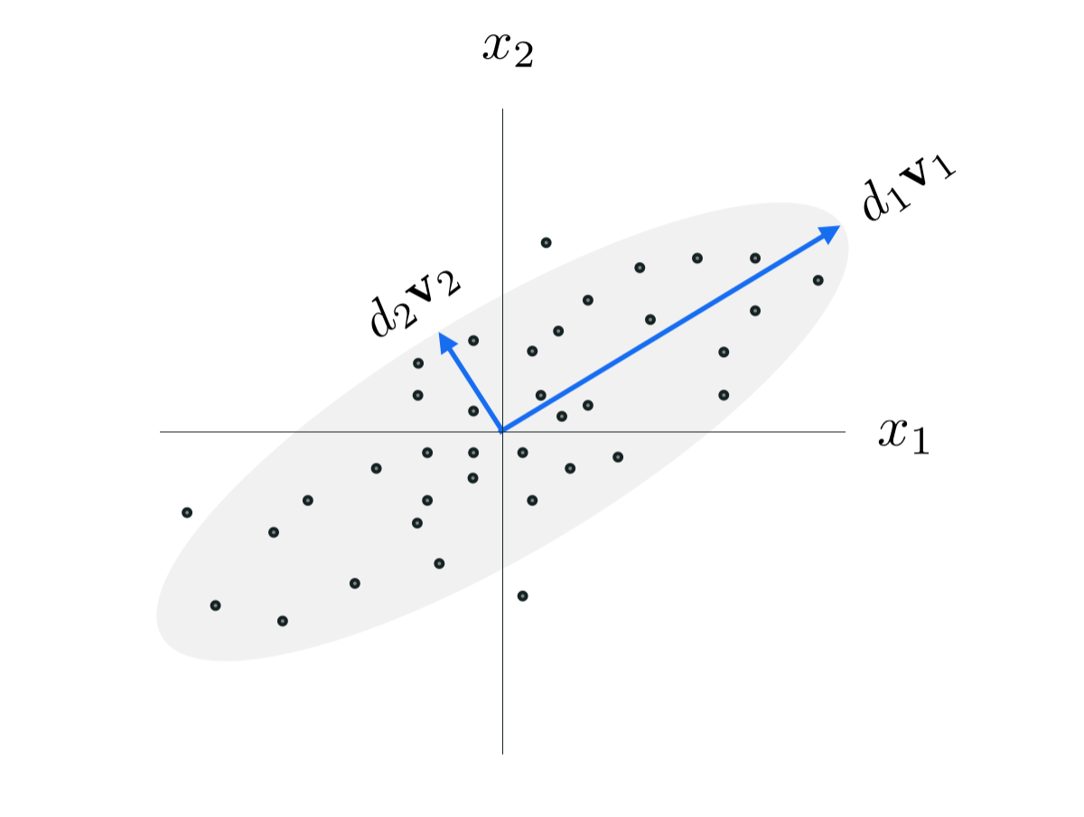
The classic orthogonal PCA minimizer of the autoencoder cost function. The elements of this basis point in the orthogonal directions of variance of the dataset, that is the orthogonal directions in which the dataset is most spread out.

Slide 36
As we show in subsection following this one, this special orthonormal minimizer of the linear Autoencoder is given by the eigenvectors of the so-called covariance matrix of the data.

Slide 37


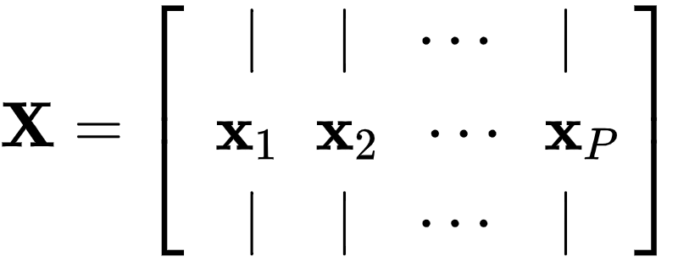
Denoting by the data matrix consisting of our P mean-centered input points stacked column-wise

Slide 38

The orthogonal basis provided by this special solution (called the Principal Components of a dataset) can be computed (as a minimum of the Autoencoder cost function) as the eigenvectors of the corresponding correlation matrix of this data

Slide 39
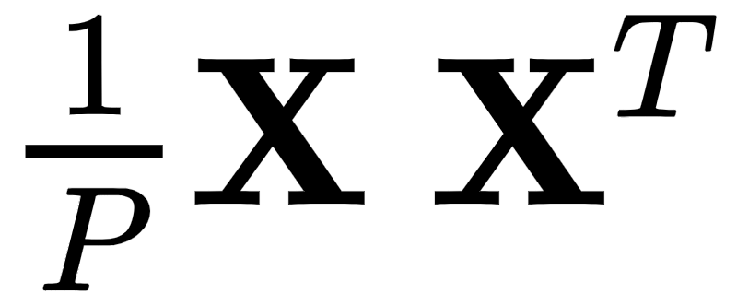
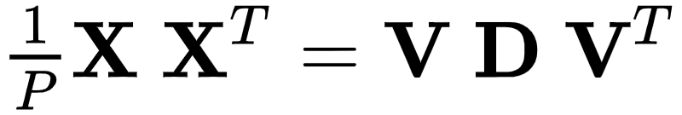

Denoting the eigenvector/value decomposition of the covariance matrix
is given as
then above the orthonormal basis we recover is given precisely by the eigenvectors above, i.e.,
Again, these are referred to in the jargon of machine learning as the principal components of the data.

Slide 40

Moreover, the variance in each (principal component) direction is given precisely by the corresponding eigenvalue in .

Slide 41
Principal Components

Slide 42
In the left panel below we show the mean-centered data first displayed in the prior example, along with its two principal components (pointing in the two orthogonal directions of greatest variance in the dataset) shown as red arrows.
In the right panel we show the encoded version of the data in a space where the principal components are in line with the coordinate axes.

Slide 43
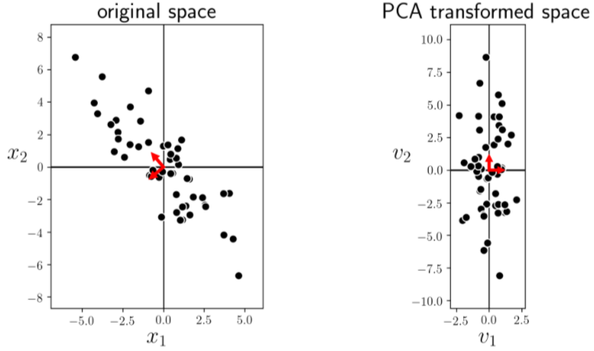

Slide 44
While PCA can technically be used to reduce the dimension of data in a predictive modeling scenario (in hopes of improving accuracy, computation time, etc.) it can cause severe problems in the case of classification.
In the figure below we illustrate feature space dimension reduction via PCA on a simulated two-class dataset where the two classes are linearly separable.

Slide 45
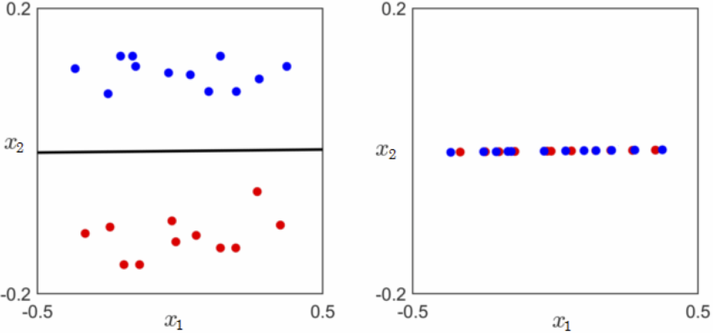
(left) A toy classification dataset consisting of two linearly separable classes. The ideal subspace produced via PCA is shown in black. (right) Projecting the data onto this subspace (in other words reducing the feature space dimension via PCA) destroys completely the original separability of the data.

Slide 46
Because the ideal one-dimensional subspace for the data in this instance runs (almost) parallel to the ideal linear classifier, projecting the complete dataset onto this subspace completely destroys the inter-class separation.
For this very reason, while it is commonplace to sphere classification data using PCA, as detailed in Section 9.5, one needs to be extremely careful using PCA as a dimension reduction tool with classification or when the data does not natively live in or near a linear subspace.

